Slide 1


Slide 2
DATE : 20, April 2020. 28, Sha’aban 1441AH
SUBJECT : Information communication Technology (ICT)
Topic : HOW TO SETUP A DESKTOP COMPUTER SYSTEM

Slide 3
In this lesson we will be achieving the following objectives.
We will be able to identify basic components that make up a computer system.
We will be able to identify cables used to connect to the System unit.
We will be able to set up a desktop computer system on our own.

Slide 4
Now lets go into the first topic
Before we go what do we mean by “setting-up” the Desktop.
It just means “connecting” the“basic components” for them to work together as a “Computer system”.
so when you set up a computer, you have connected all components to make it work.

Slide 5
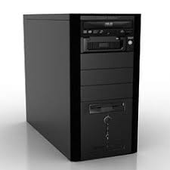
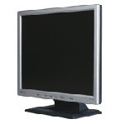
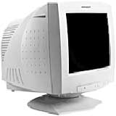
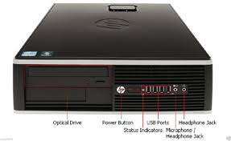
These components are
1. The Monitor.
2. The System Unit

Slide 6
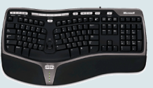

3. The keyboard
4. The mouse

Slide 7
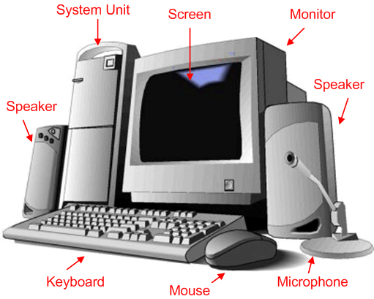
Computer System

Slide 8
The following cables are used
The Video Graphics Array(VGA) cable: This connects the Monitor to the System Unit.
Universal Serial Bus (USB) cable: This cable is used to connect the modern keyboard and mouse to the system.
Power cable : This cable is connected to the source of electricity to distribute power to the system unit. The Monitor and the System unit require a power cable
PS/2 Mouse : This cable is used for older mice and keyboards.

Slide 9
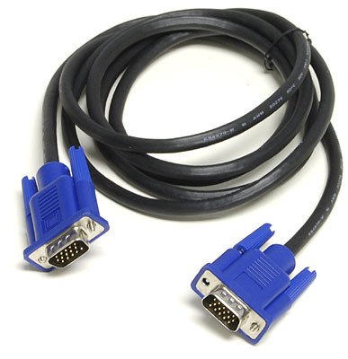
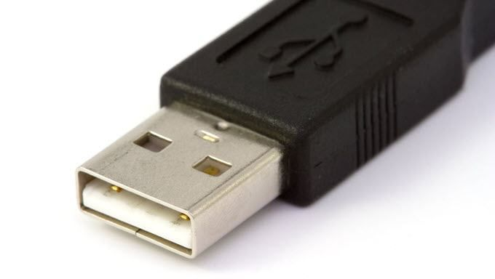
1. VGA cable
2. USB cable:

Slide 10
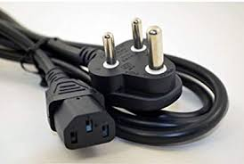
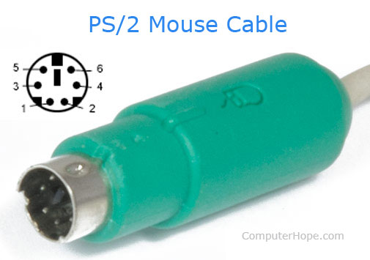
1. Power Cable
2. PS/2 cable

Slide 11
Quiz time!!!!! Quiz time!!!!! Quiz time!!!!!
Which of the following require a USB cable:
a. Mouse and Keyboard
b. Monitor and System Unit
c. Monitor only
d. Mouse only
For the monitor and systemunit to work, we require
a. USB cable
b. VGA cable

Slide 12
MASHA ALLAH
have a tea☕
Now Give Yourself a loud Takbeer
You have just completed the first stage
shall we go to the next stage..

Slide 13
Connecting the components to the System Unit
Remember!!!!
Every component must be connected to the “System Unit”.

Slide 14
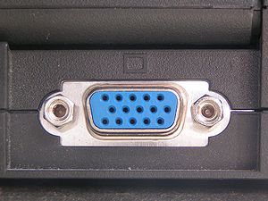
connecting the Monitor to the system unit fill in the blanks____
To connect the monitor to the system unit we use the _______ cable
we look for a port like this
both on the Monitor and the System Unit
the we connect them together using this this

Slide 15
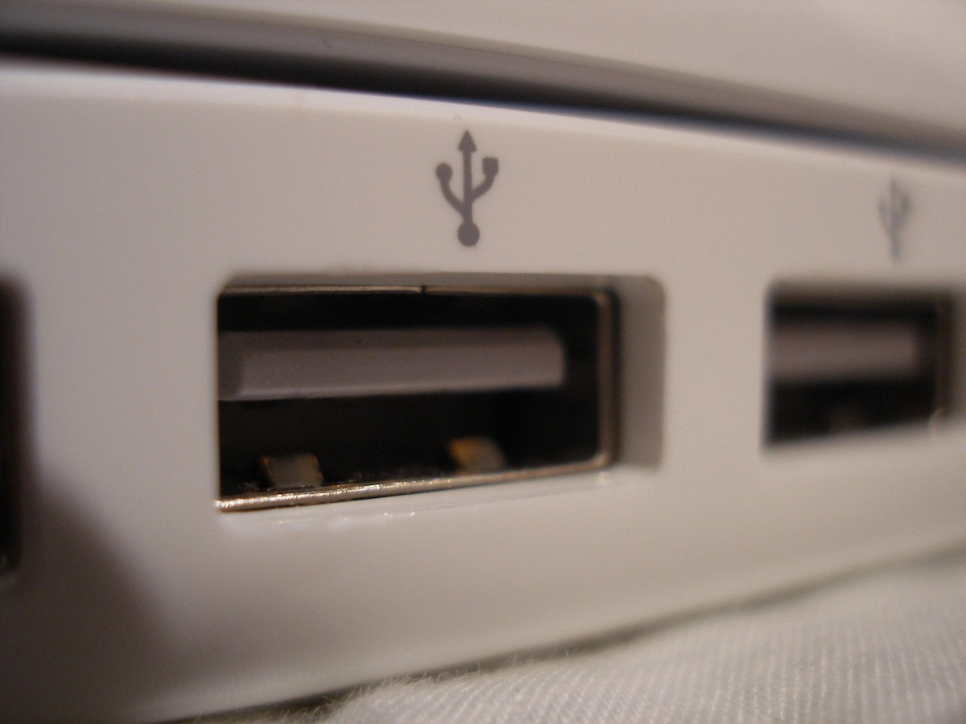
connecting the keyboard and mouse to the system unit fill in the blanks____
To connect the keyboard and mouse to the system unit we use the __________ cable.
we look for a port like this
on the System Unit
then we connect our keyboard and mouse USB cable to it.

Slide 16
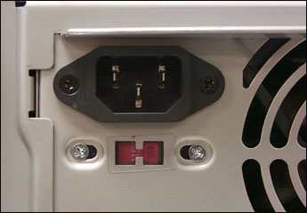
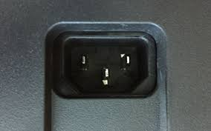
Connect Monitor and System Unit to Power Source
We Connect the _______ cable of the System unit to power source.
we also connect _______ cable of the Monitor to the power source

Slide 17

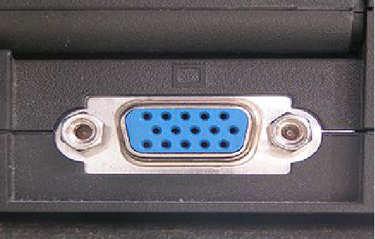
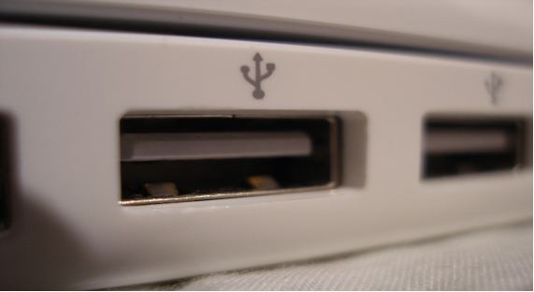

So in summarry to set up the computer we connect.
System Unit and Monitor
Keyboard and Mouse

Slide 18
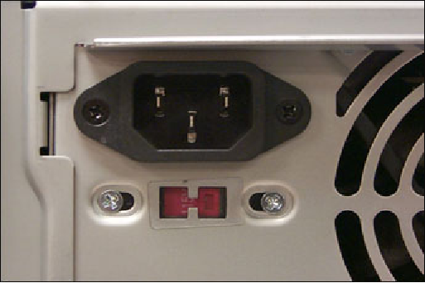
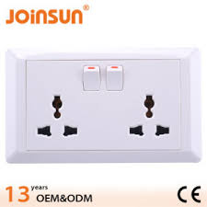
then
System Unit and Monitor
Power source

Slide 19
Alhamdulillah
Masha Allah.
Now you know how to set up a desktop computer.
now watch this beautiful video for more understanding here

